Slide 1
A Pattern-Matching Scheme With High Throughput Performance and Low Memory Requirement
Author: Tsern-Huei Lee, Nai-Lun Huang
Publisher: TRANSACTIONS ON NETWORKING,2012
Presenter: Jia-Wei,Yu
Date: 2013/3/6

Slide 2
Introduction
This paper presents a pattern-matching architecture with high throughput performance and low memory requirements.
Similar to the WM algorithm.
Shift table is replaced by Membership query module and Master bitmap.
Prefix table is replaced by compressed AC.

Slide 3
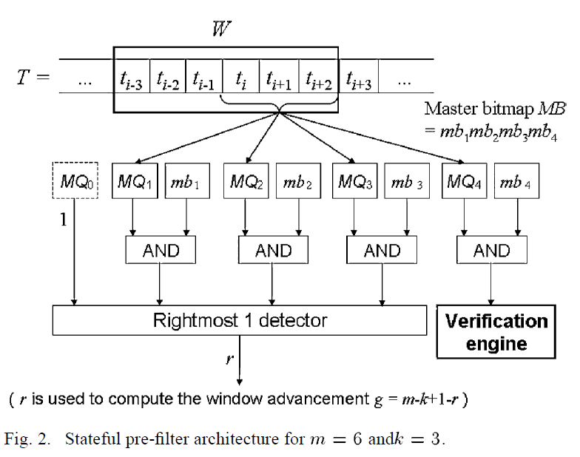
Architecture

Slide 4
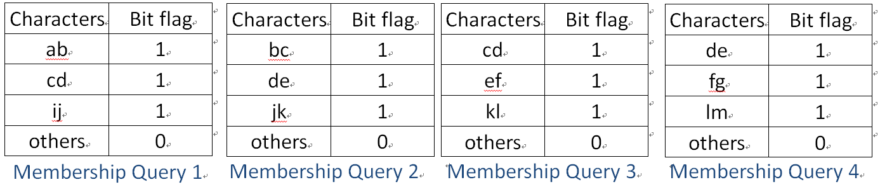
Pre-filter design (1/6)
Pattern set : abcde, cdefg, ijklmn
Window = 5, block = 2

Slide 5
Pre-filter design (2/6)
Input data :xyzcdabcde
MB (master bitmap) = 1111
xyzcdabcde
QB (query bitmap) = 1010
MB = MB & QB = 1010

Slide 6
Pre-filter design (3/6)
MB = 1010
Shift = m-k+1-r full match ?
shift = 5 – 2 + 1 – 3 = 1 => 1 : full match , 0 : do nothing
MB = MB >> 1
MB = 1101
Filled with 1’s for the holes left by the shift.

Slide 7
Pre-filter design (4/6)
xyzcdabcde
MB = 1101
QB = 0000
MB = MB & QB = 0000 , shift 4
=> MB = 1111

Slide 8
Pre-filter design (5/6)
xyzcdabcde
MB = 1111
QB = 0101
MB = MB & QB = 0101 , do full match , shift 2
=> MB = 1101

Slide 9
Pre-filter design (6/6)
Input data : xxxdefxxx
MB = 1111 , QB = 0010
MB = MB & QB = 0010 , we can shift 1 byte
Possible : xxdex
Impossible : xdexx , dexxx
Input data : xxxdefxxx
MB = 1001 , QB = ????
Can shift 3 bytes or more.

Slide 10
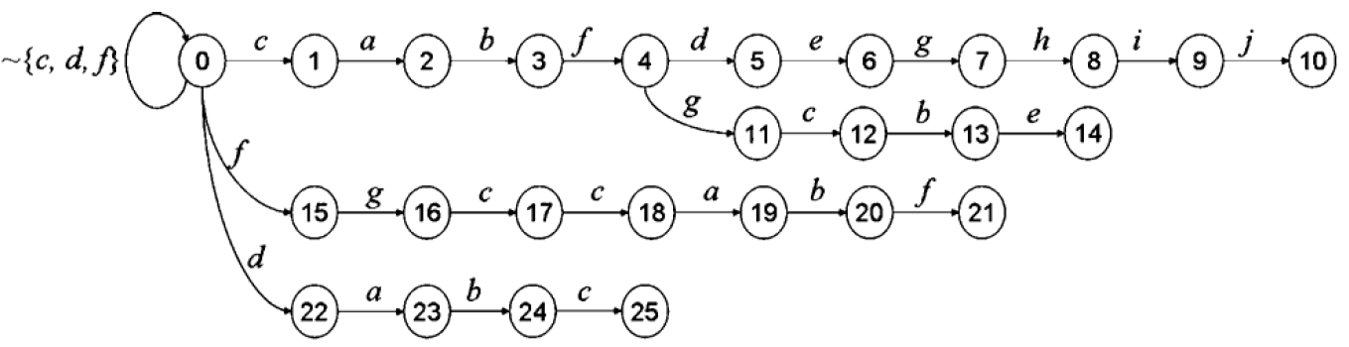
Verification engine (1/5)

Slide 11
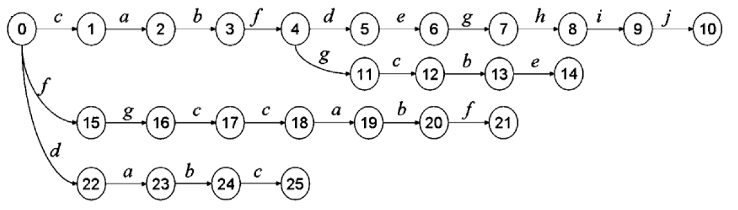
Verification engine (2/5)
Branch state
First single child state
Leaf state / match state

Slide 12
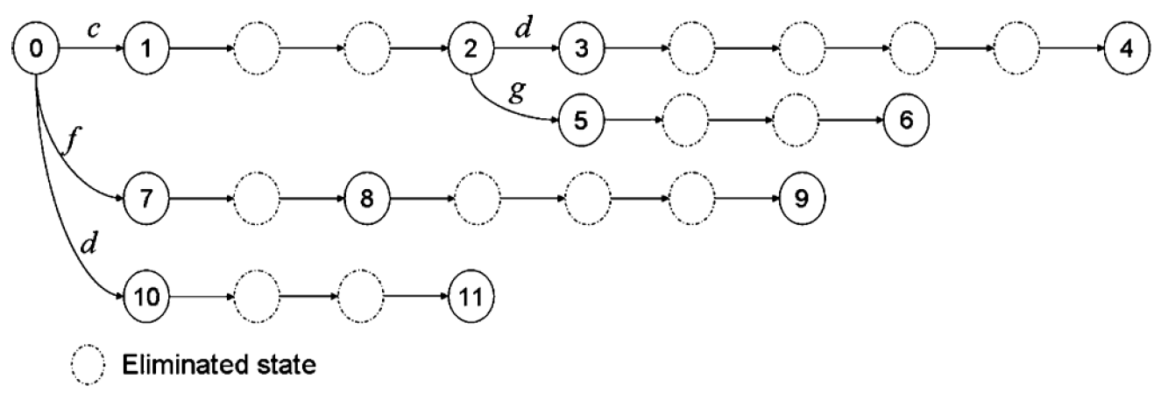
Verification engine (3/5)

Slide 13
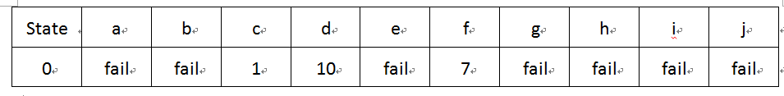
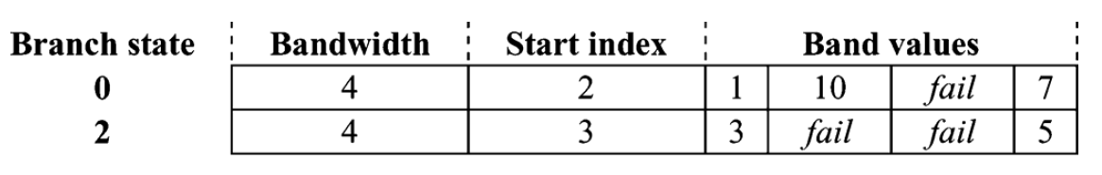
Verification engine (4/5)
Our design needs two bits for every explicit state to indicate its type (branch, single-child, or leaf) and another bit to indicate whether or not a match is found in the state.

Slide 14
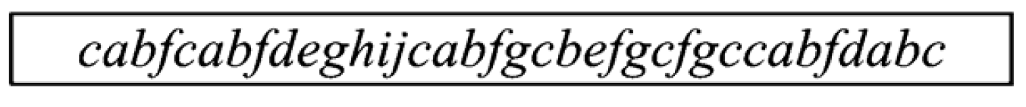
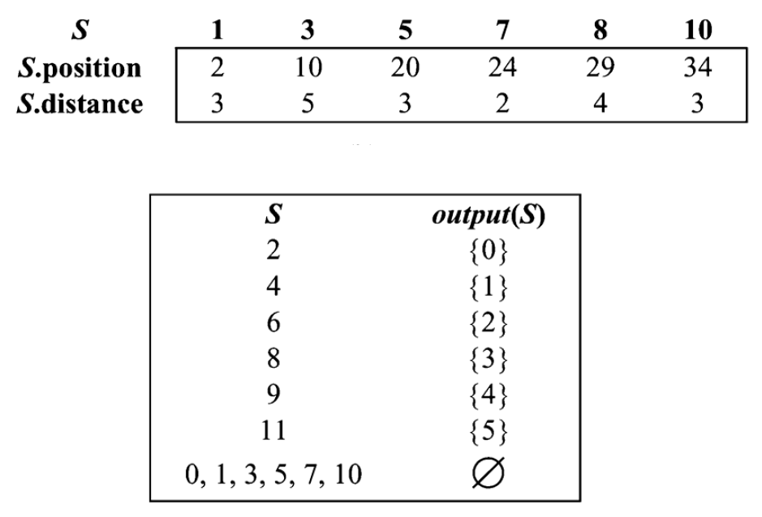
Verification engine (5/5)
Compacted_Patterns

Slide 15
Experimental result (1/6)
The experiments are conducted on a PC with an Intel Pentium 4 CPU operating at 2.80 GHz with 512 MB of RAM, 8 kB L1 data cache, and 512 kB L2 cache.
The entire ClamAV pattern set is used, containing 29179 string signatures. The minimum, maximum, average, and total lengths of the signatures are 10, 210, 66.43, and 1938433 B, respectively.
The total number of states generated by the AC algorithm is 1844895.
Input data : 2.2 MB

Slide 16
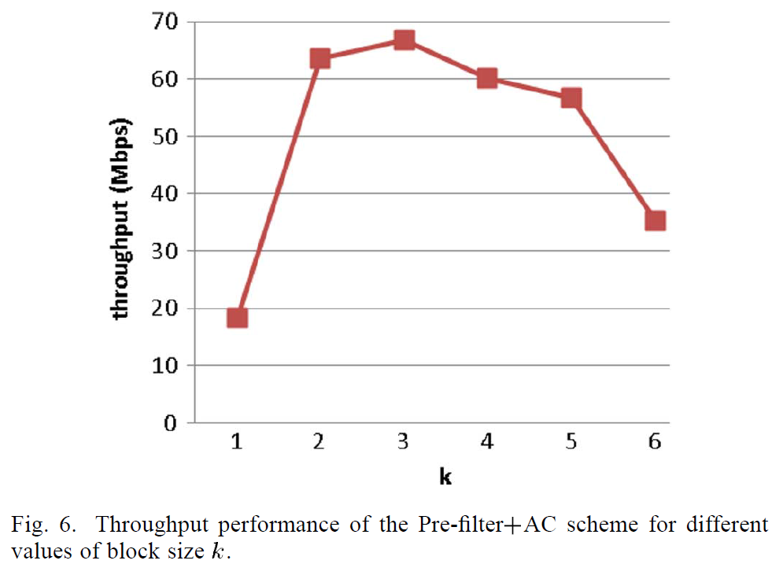
Experimental result (2/6)

Slide 17
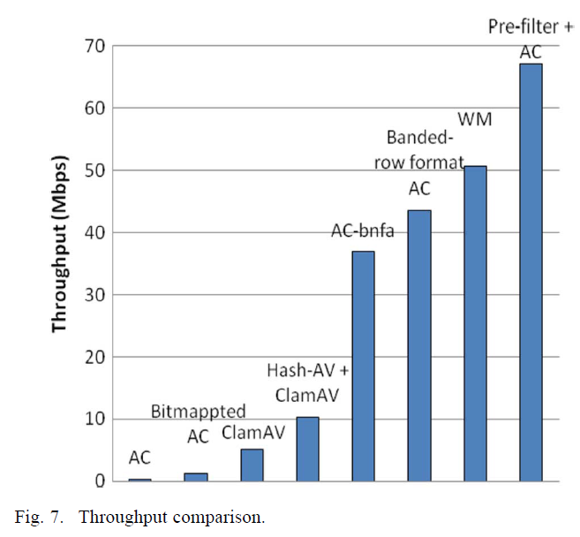
Experimental result (3/6)

Slide 18
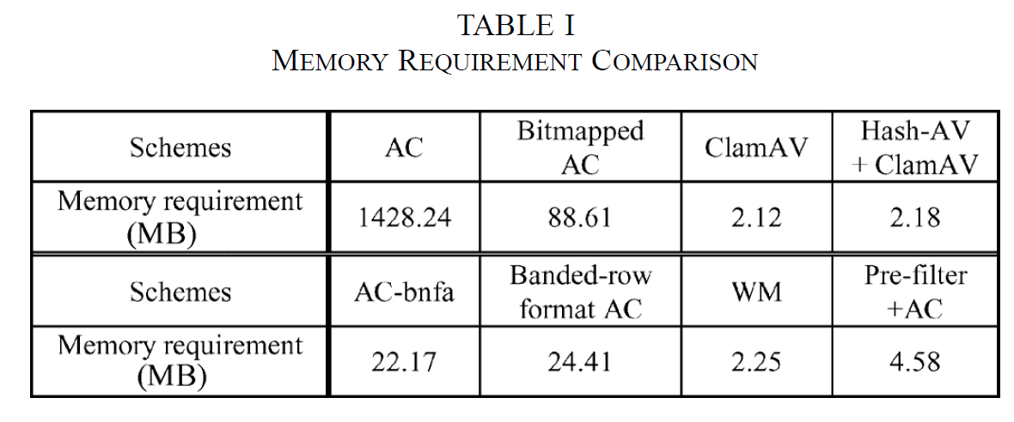
Experimental result (4/6)

Slide 19
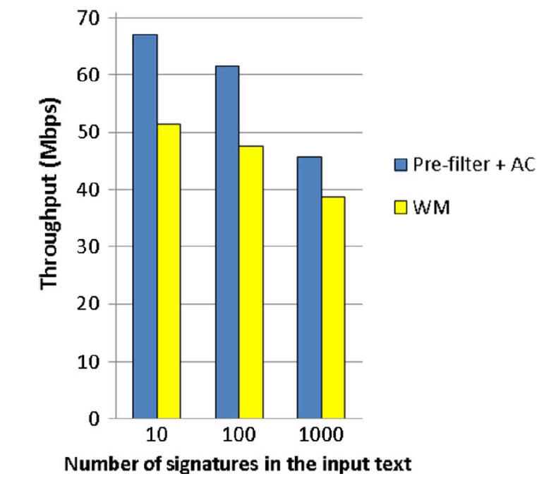
Experimental result (5/6)
If the average size of a malicious program is 1 kB, then the respective fraction of malicious traffic for 10, 100, or 1000 signatures is about 0.45%, 4.5%, or 45%.

Slide 20
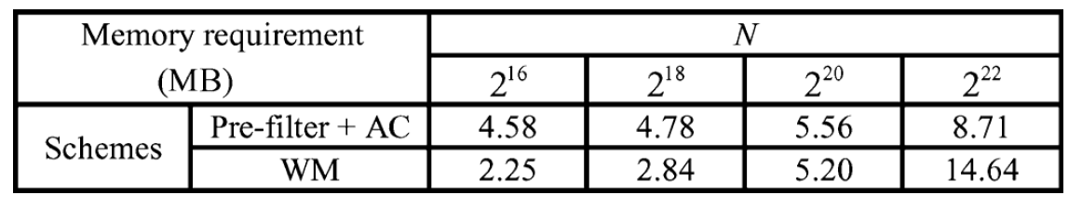
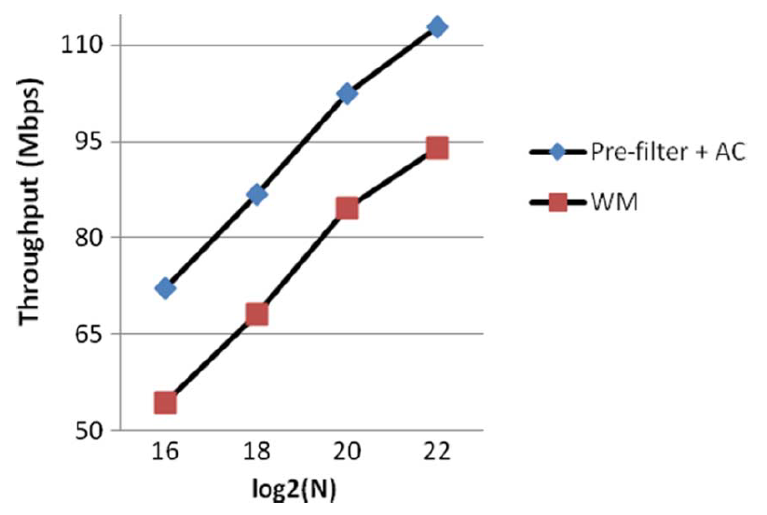
Experimental result (6/6)

